Slide 1
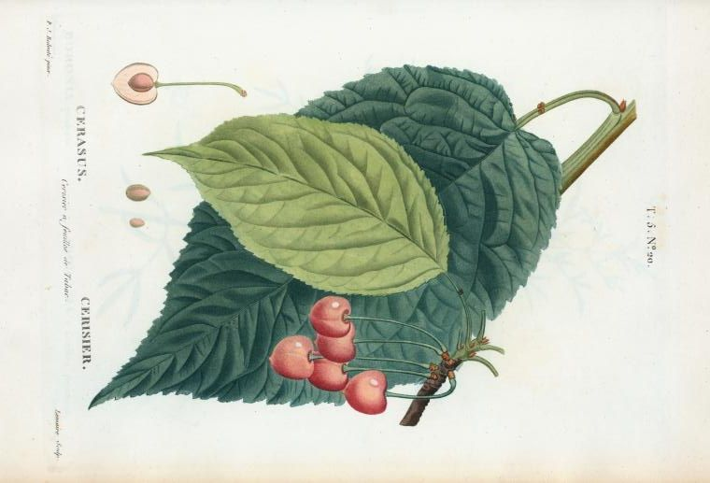
Botanical Illustration & Watercolor
UHCL ART SCHOOL
Kaylyn Sellers - August 2022 Methods in Elementary Art ARTS4300 Prof. Moya

Slide 2
Objectives : We will…
01
02
03
We will explore the historical significance of botanical art.
We will investigate the purpose and effectiveness of artworks created by historic men and women in various cultures.
We will explore techniques and vocabulary in watercolor. We will produce a watercolor painting from life.
04
TEKS 117.117 -b.3. A & B Historical & Cultural Relevance TEKS 117.117- b.1. B Foundational Vocabulary TEKS 117.117 -b.2. C Creative Expression

Slide 3
Table of Contents
01
03
02
04
History
Vocabulary
What is it? What was it used for?
Why do you think it’s important?
Watercolor words & techniques you need to know!
Botanical Project expectations
Famous Botanical Artists
Prominent people within the botanical art world.
Materials and requirements for our project

Slide 4
01
History
What do you know about it?
What is it?
What was it used for?
Why do you think botanical illustrations were important?
Let’s Explore!

Slide 5
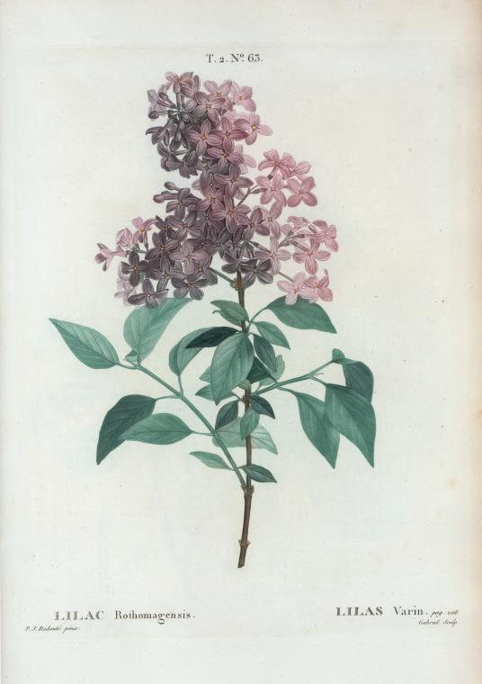
What is Botanical Illustration?
INTRODUCTION
Botanical of or relating to plants, or botany, which is a branch of biology that studies the properties and life stages of a plant
Illustration to provide with visual features, like that of a picture or diagram, intended to explain or make things clear
Botanical Illustration A visual picture or diagram intended to show plants and their biology which aids the study of its properties and life stages
What was it used for?
Botanical art was used as a way to study, catalogue, and identify plants!

Slide 6
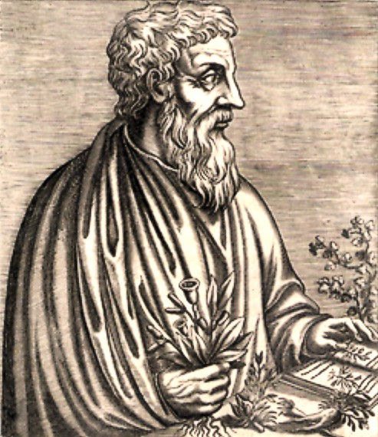
History: The Early works
Let’s Explore!

Slide 7
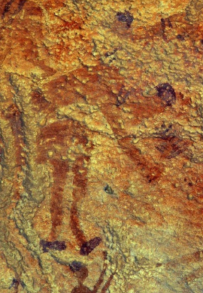
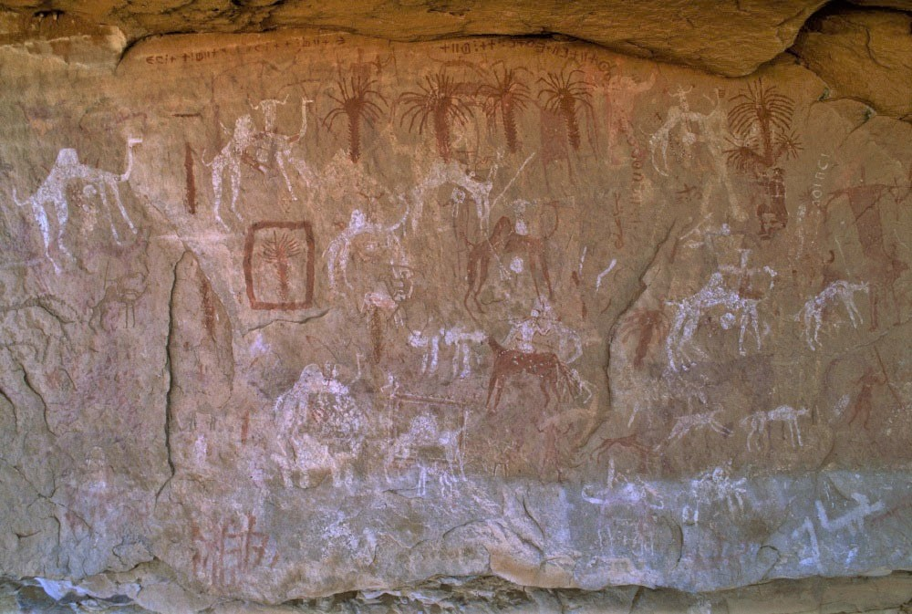
Libya (North Africa)
Palm trees appear at the top of this panel painted in red ochre different from kaolin or lime white humans and dogs herding camels. Wadi Teshuinat, Acacus Mountains, Libya. 2013 © David Coulson/TARA 2013,2034.5117
Estimated 9th-3rd century BC.
A human figure bends at the waist and holds a plant in his hand. Libya. Date and exact location unknown.

Slide 8
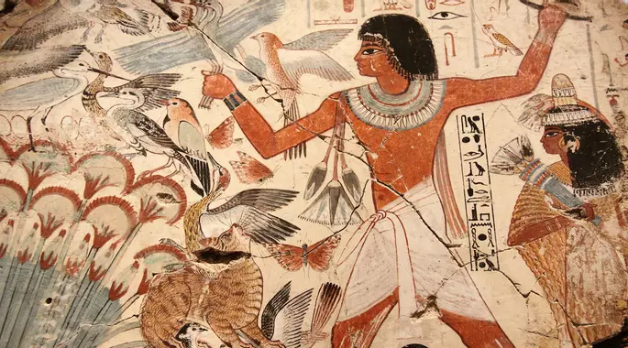
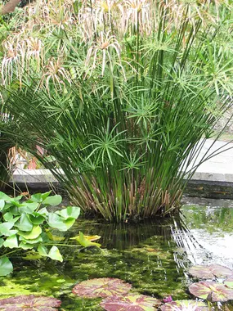
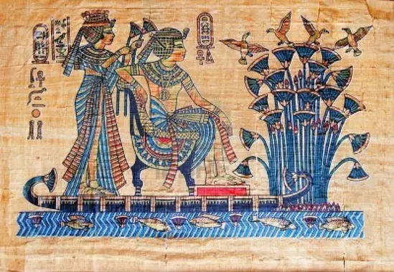
Egypt (North Africa)
Ancient egyptians depicting the papyrus plant
Decorative uses of plants on wall paintings, carvings, and on ceramics or coins date back to at least ancient Egypt and Mesopotamia, more than 4,000 years ago.
DID YOU KNOW? Cyperus papyrus, the papyrus plant, is where the word paper comes from

Slide 9
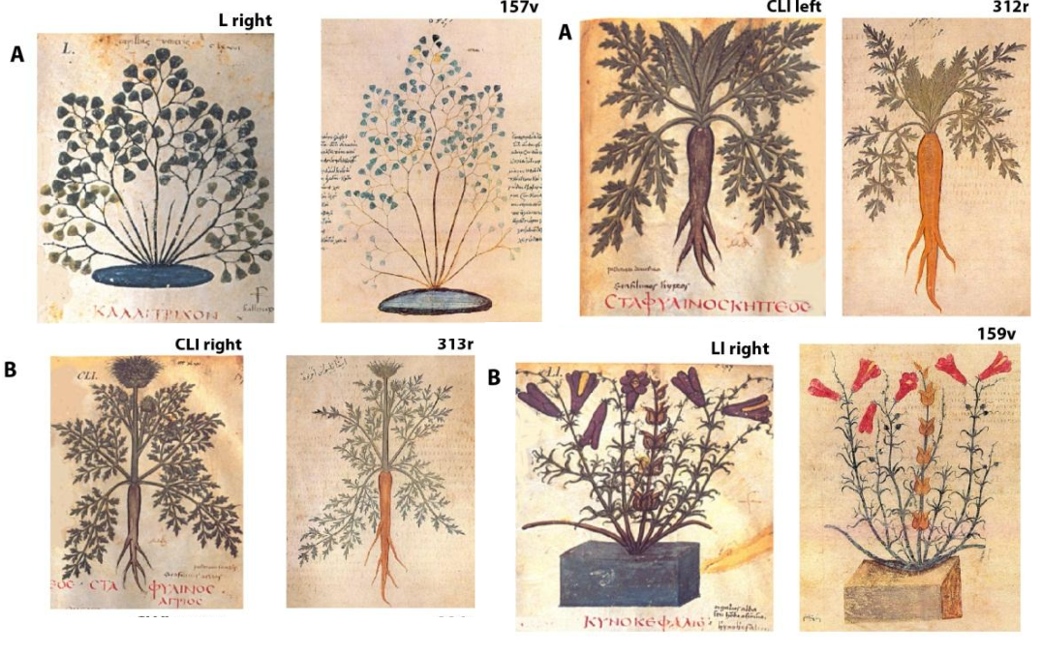
Constantinople, Roman Empire - (Istanbul, Turkey)
Pedanius Dioscorides (Peh-dany-us Dye-o-scor-ridies)
Lived: 40 AD to 90 AD Physician for the Roman Army, pharmacologist & botanist. His book was the precursor to all modern pharmacopoeias, and was used for 1500 years. Shared all over the world via roman trading routes.
The earliest surviving illustrated botanical work is the Vienna Dioscorides. It is a copy of Dioscorides’ De Materia Medica, and was made in the year 512 for Juliana Anicia, daughter of the former Western Roman Emperor Olybrius.
DID YOU KNOW? Ancient Greeks and Romans used carrots to treat stomach aches

Slide 10
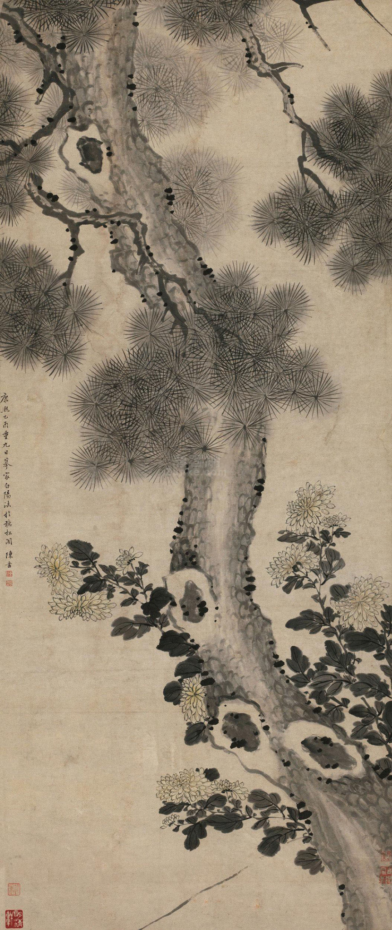
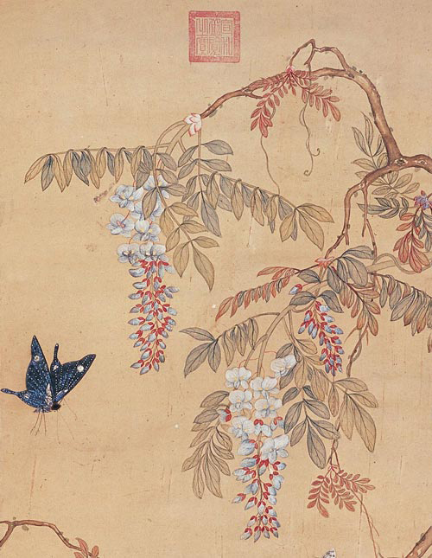
Flower painting in China
Started around 4,000 BC, initially it was associated with Buddhist art. It became very popular in the 10th century and was established as a proper art form during the Tang dynasty (618-907) - which is is regarded as a highpoint of Chinese culture, unfortunately little of it survives.
Pine Tree and Chrysanthemums by Chen Shu 1705
Butterfly and Chinese wisteria flowers by Xu Xi (Hsü Hsi) Tang c.970

Slide 11
Reflection: Why do you think Botanical Illustrations were important ?
Some things to consider:
What was life like then?
What technology did they have available to them?
What are plants uses?
Why did we look for new plants?
How would drawing them help others?
Consider your reasonings for why artist’s creating botanical illustrations served an important role in history

Slide 12
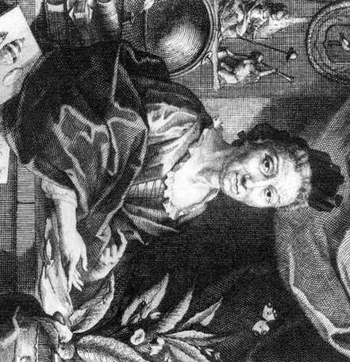
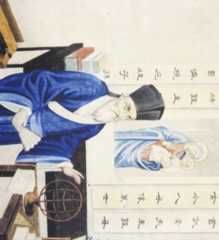
02
Famous Botanical artists
Established as an art and formal science

Slide 13
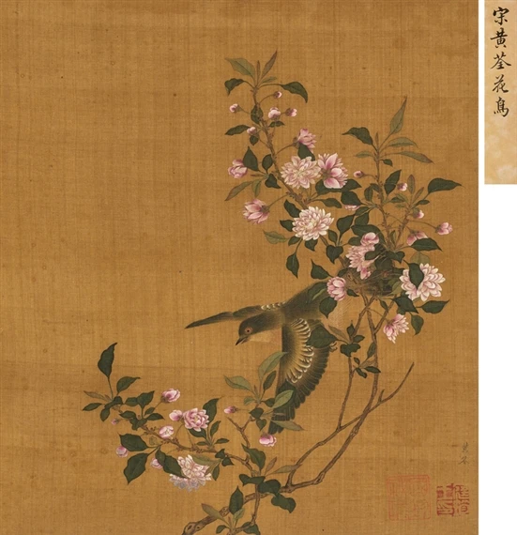
Huang Quan
Huang Quan [who-an chOO-an] (courtesy name Yaoshu)
He began his study of painting at the age of 12 with the bird-and-flower painter, Diao Guangyin, in 903. By the time he was 16, he became an imperial attendant in the Paining Academy of Former Shu State, and painter of the Queen of Former Shu. He was a prolific artist, with a recorded 349 known works, but unfortunately few still exist today. His paintings are based on rare palace birds, auspicious (lucky) birds, famous flowers and stones. His style frequently used a pen to outline his works.
*How would you classify this art work? (portrait, still life, landscape, etc.)
Huang Quan Birds and Flowers Silk Decorative Art 26 × 23 cm.

Slide 14
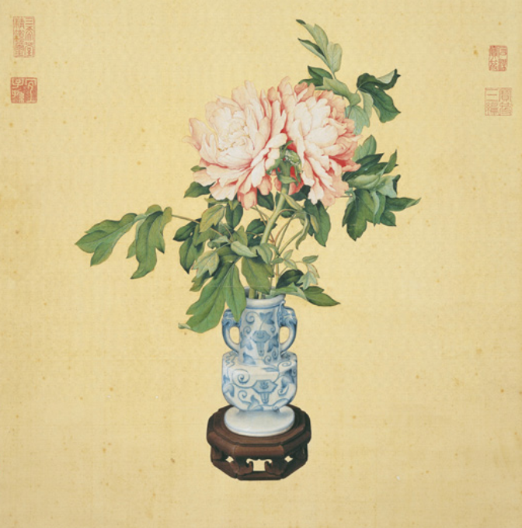
Giuseppe Castiglione
*How do you think the artist came up with ideas for their artwork?
(AKA Lang Shining ) Lived: 1688-1766 Hailing from San Marcelino district of Milan, Italy, he was educated at home with a private tutor and later learned to paint under the guidance of a master. By 19, he became an Jesuit lay brother.
Jesuits in China made a request for a painter to work for the emperor. His skill was appreciated especially by the Qianlong Emperor, and he served him for 30 of his 50 years in court. Through his time spent there, he blended both Chinese and European styles in his works.
Lang Shining (郎世寧, 1688-1766), Qing Dynasty (1644-1911)
Peonies in vase.
Hanging scroll, ink and colors on silk, 113.4 x 59.5 cm, National Palace Museum, Taipe

Slide 15
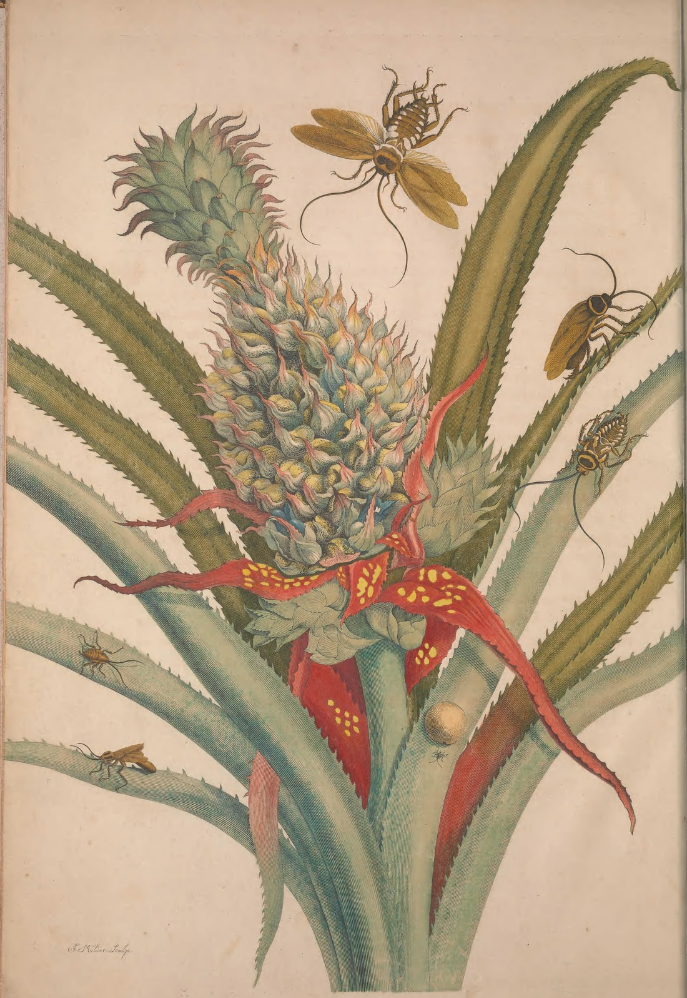
Maria Sibylla Merian
*What objects do you see in the artwork?
Lived: April 2, 1647 - January 13, 1717
Born Frankfurt, Germany to a family of Swiss heritage. This is a centre for the silk trade - and the silkworm was very important to the town.
Maria was a woman of both Art and Science She was a Naturalist, an Entomologist and a Botanical Illustrator who was the first to record metamorphosis of insects.
Merian's ran an all-female scientific illustration workshop in Europe and she used the money she made from her scientific illustration to fund research trips to South America - in an age when science was largely the pursuit of independently wealthy men, Merian was (even more!) unusual in that she made her living from art and science.
Plate 1 from Metamorphosis in Surinam by Maria Sibylla Merian by Merian (c. between 1701 and 1705) Hand coloured copper engraving 20 1/2 x 14 1/2 in

Slide 16
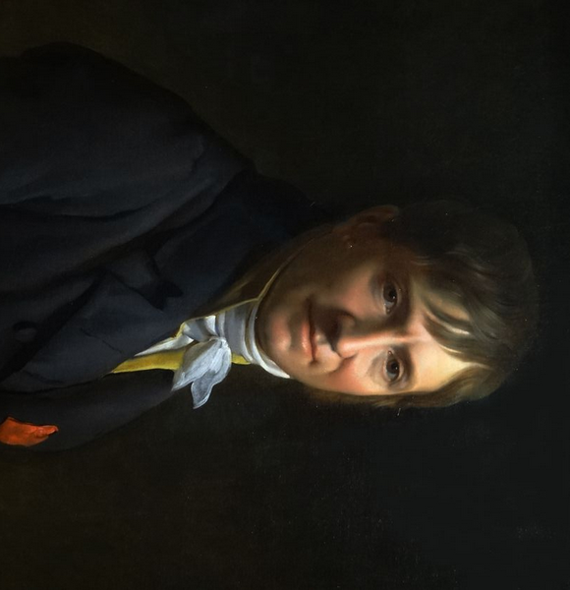
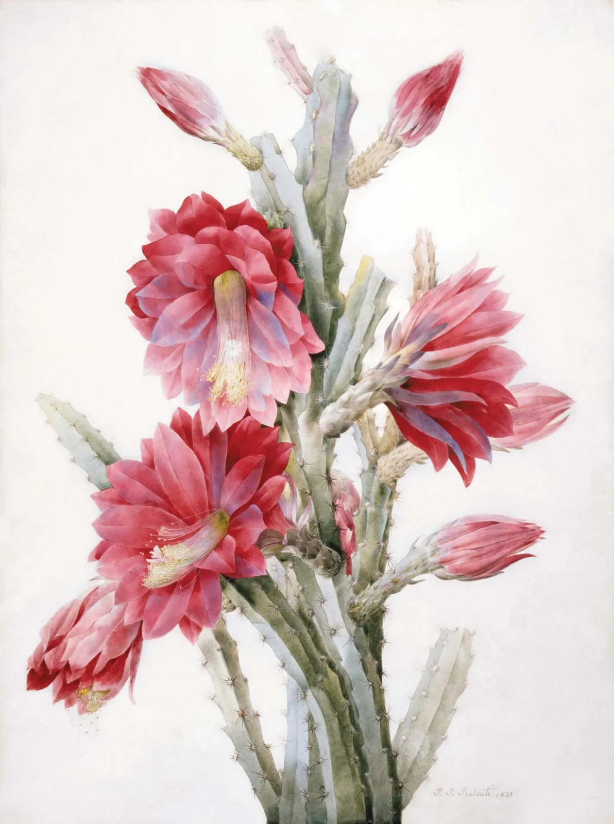
Pierre- Joseph Redouté
What style of art is used in the art work?
Lived: July 10, 1759 – June 19, 1840 Born in Belgium, trained by botanists in France and created most of his work there. He was a prolific artist, he produced over 2,100 paintings for published plates depicting over 1,800 different species, many of which had never been rendered before. His two famous books were:
Les Liliacees (1802 - 15) 500 plates of lilies Les Roses (1817 - 21) He's best known for his roses. His series of rose paintings are his finest work.
He painted for the kings of France from Louis XVI to Louis-Philippe, and was an art tutor to Queen Marie Antoinette .
A Flowering Cactus: Heliocereus Speciosus, 1831 Watercolor on Vellum 27 3/4 × 22 1/2 in
Notes:
Born in Belgium, he was the second of three brothers who were all artists. He was trained by botanists in France and created most of his work there. He was a prolific artist, he produced over 2,100 paintings for published plates depicting over 1,800 different species, many of which had never been rendered before. His two famous books were:
Les Liliacees (1802 - 15) 500 plates of lilies Les Roses (1817 - 21) He's best known for his roses. His series of rose paintings are his finest work.
He painted for the kings of France from Louis XVI to Louis-Philippe, and was an art tutor to Queen Marie Antoinette .

Slide 17
PLANTS OF THE GLOBE
Ananas Comosus var. Comosus
Origin and Habitat: Brazil and Paraguay Maria Sybilla Merian, 1701-05
Heliocereus Specious
Origin and Habitat: Sacatepequez, Guatemala Pierre Joseph Redouté, 1831
Phoenix dactylifera
Origin and Habitat: Middle east, but spread to North Africa.
Daucus carota subsp. sativus
Origin and Habitat: Persia (modern day Iran) but spread to the Mediterranean
Cyperus Papyrus
Origin and Habitat: Egypt
Wisteria Sinensis
Origin and Habitat: Southern China Xu Xi, 970
Paeonia Lactiflora
Origin and Habitat: Northern China and Siberia Artist: Giuseppe Castiglione

Slide 18
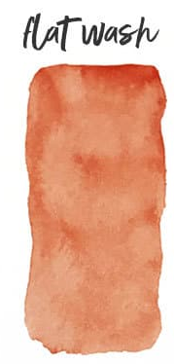
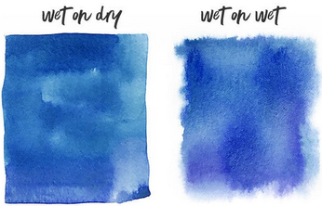
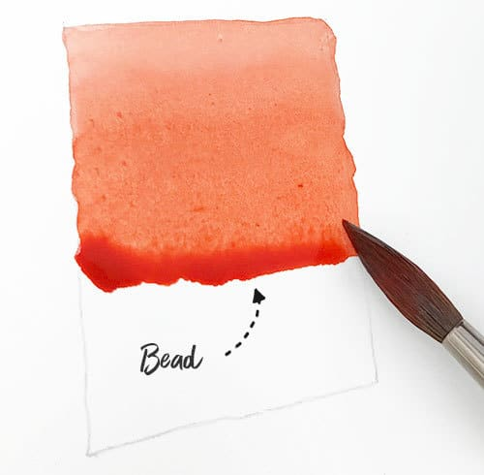
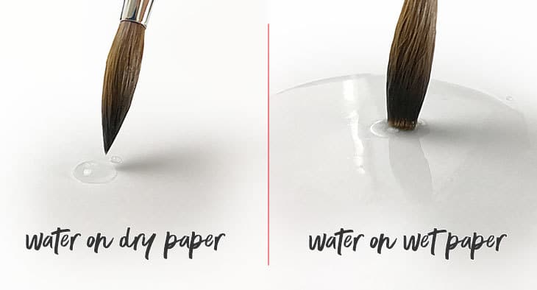
03
Vocabulary: Words To Know
Color | Refers to wavelengths of light, hue (name of color) value (lightness/darkness of color) and temperature (warm or cool)
Wash | Flat even distribution of water or color on watercolor paper
Wet on Dry | means that you’re applying wet paint onto dry paper, or wet paint onto an area of dry paint
Wet on Wet | means that wet paint is applied to wet paper, or added to a wash of fresh wet paint

Slide 19
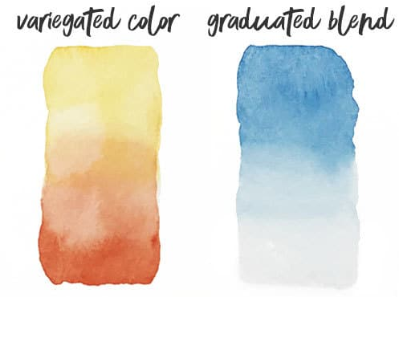
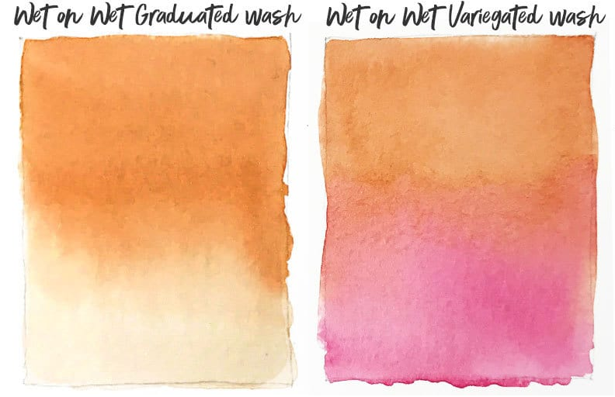
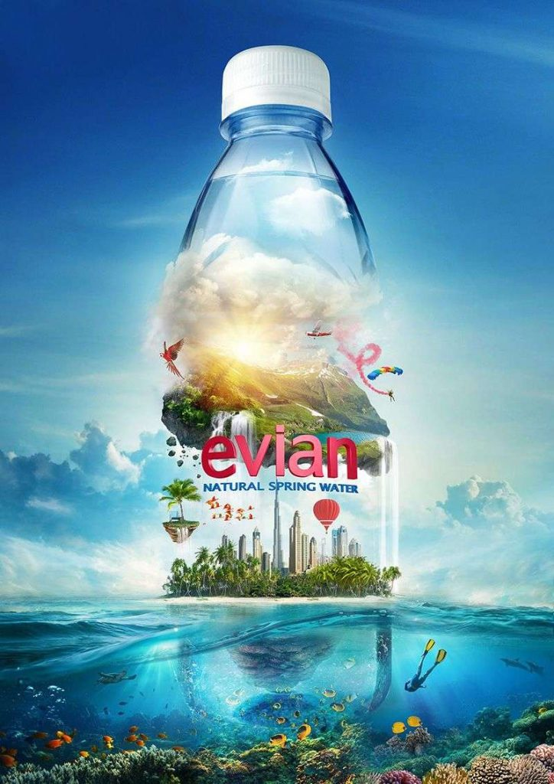
03
Vocabulary: Words To Know
Glazing | A thin layer of paint on top of another layer of dry paint
Gradient | Includes variegated color, and graduated blend
Graduated blend | a smooth gradient of different paint intensity from dark to light, can be wet on dry or wet on wet
Variegated color | A glaze from light to dark on top of another layer of dry paint, can be wet on dry or wet on wet
Balance | Sense of symmetry an object or image has, determine by a distribution of equal visual weight throughout all or part of the image

Slide 20
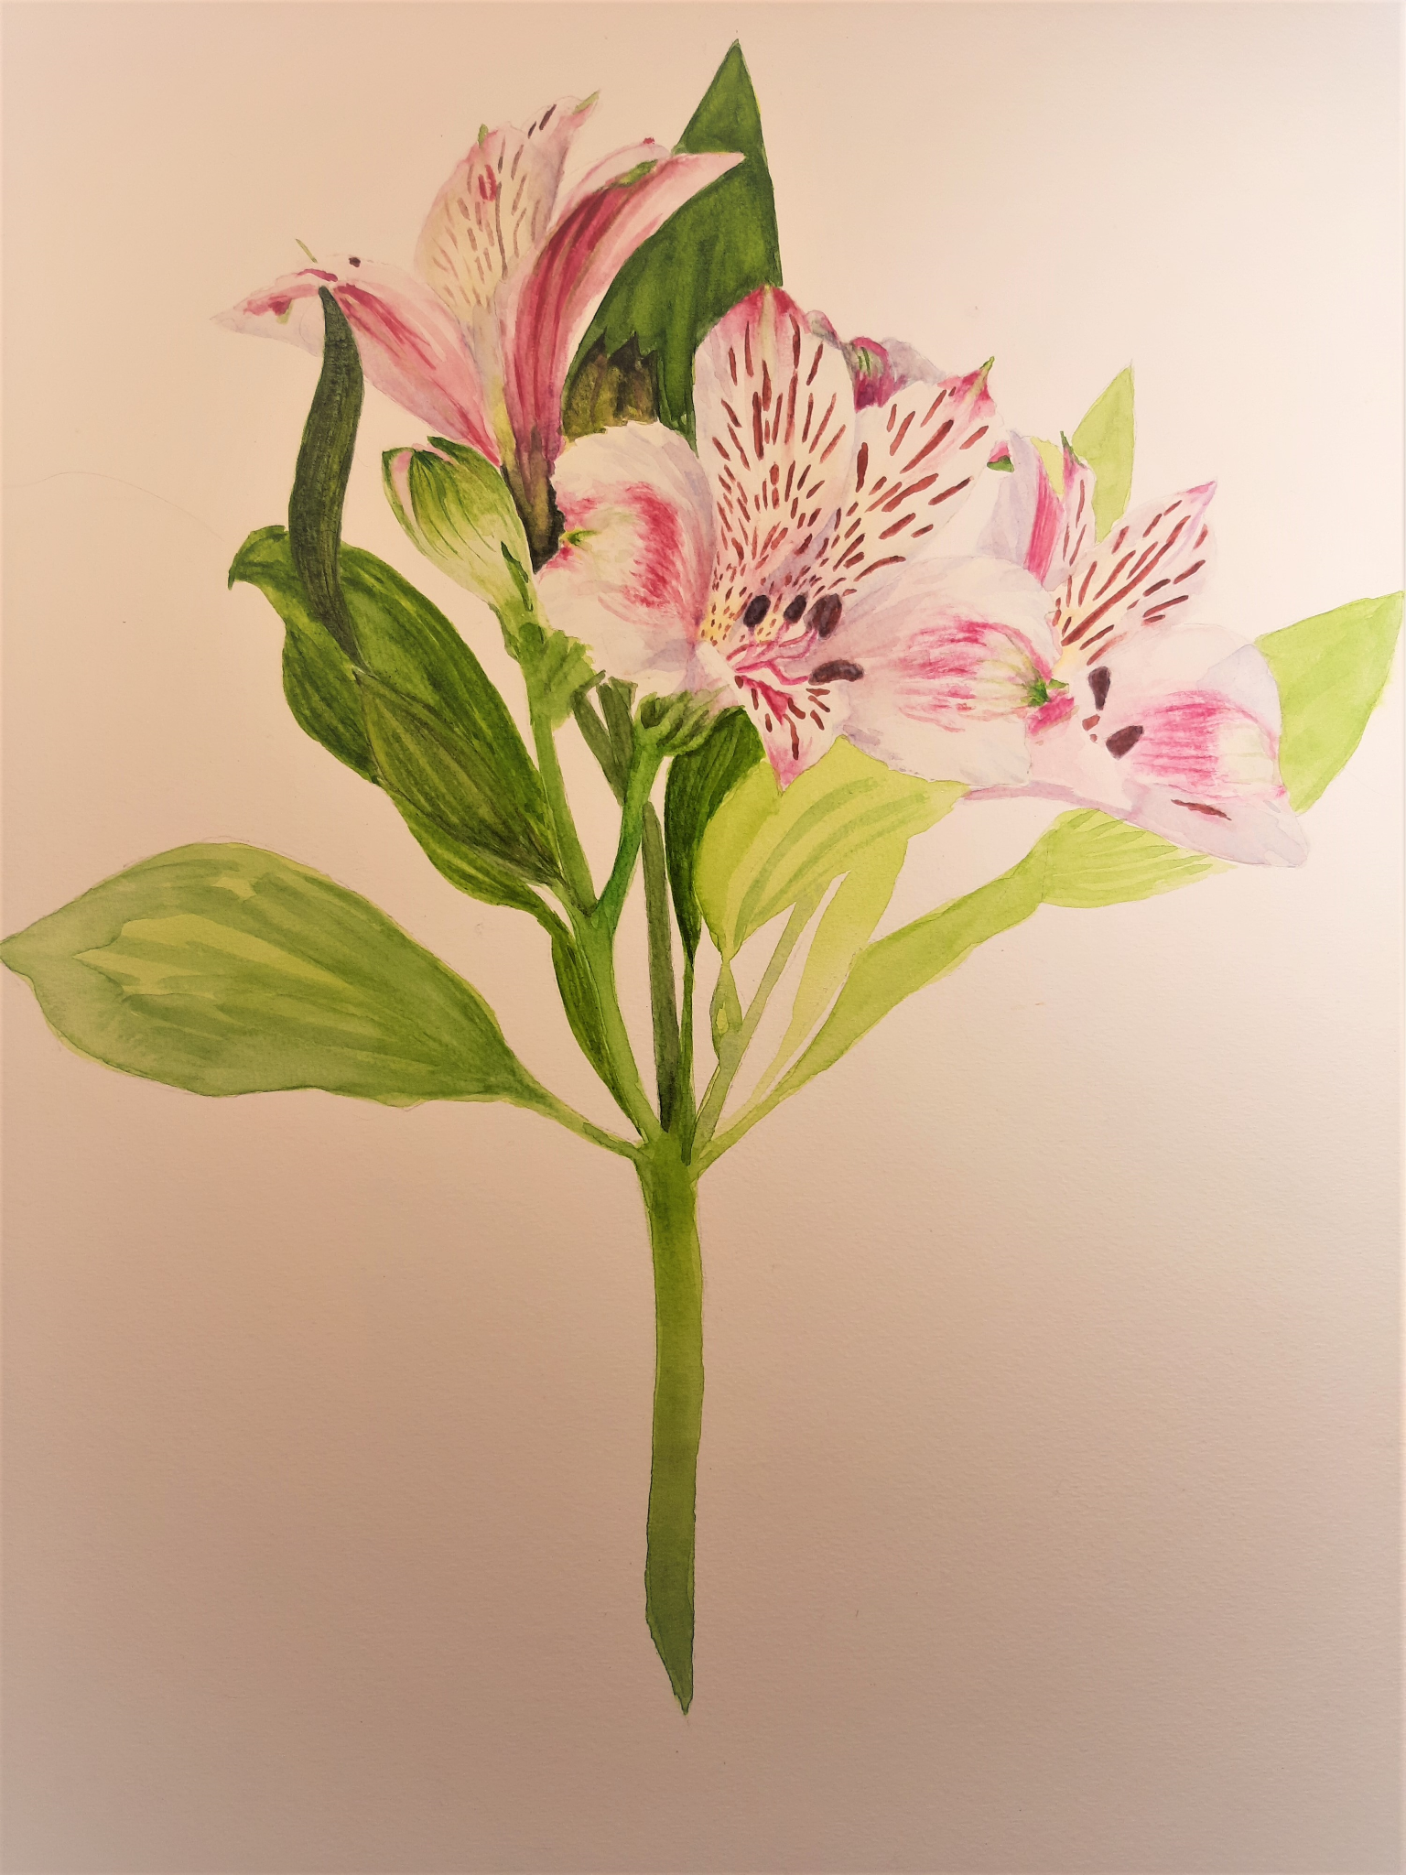
Teacher’s Example and Demonstration
Alstroemeria, commonly called the Peruvian lily or lily of the Inca
Native to the cool mountain ranges of the Andes in Chile, Brazil and Peru Optional Immersive Audio: https://www.youtube.com/watch?v=g-Tu2-B4-0o

Slide 21
04
Botanical Project Requirements
Materials Needed
Expectations
HB pencils Erasers 12x16 Watercolor Paper Scrap Watercolor Paper
Watercolor pan sets
Brushes (6 large, 8 medium and 3/0 small) Basins
Fill your paper, 1 inch margins maximum! 2 finger rule Neat, careful washes, gradation and detail work.
Timeline
Day 1: Select a flower you wish to reproduce and draw lightly. Initial Washes.
Day 2 : Secondary Washes and Detail work
Day 3: Detail work & Finalization

Slide 22
THANKS!
Do you have any questions?

Slide 23
SOURCES CITED:
https://www.merriam-webster.com/dictionary/illustrate https://www.merriam-webster.com/dictionary/botanical https://asba-art.org/article/history-botanical-art-part-1-early-portrayal-plants https://digitalcollections.nypl.org/items/510d47dc-8d25-a3d9-e040-e00a18064a99 https://www.semanticscholar.org/paper/Ancient-Greek-Illustrated-Dioscoridean-Herbals%3A-and-Janick-Stolarczyk/1d71084f8efe787489c04a2b520a6cb71803587f/figure/2 https://www.voir-ou-revoir.com/2017/10/le-pouvoir-des-fleurs-pierre-joseph-redoute-musee-de-la-vie-romantique-paris-sept-2017.html https://www.llifle.com/Encyclopedia/CACTI/Family/Cactaceae/7266/Heliocereus_speciosus https://digitalrepository.trincoll.edu/cgi/viewcontent.cgi?article=1002&context=exhibitions https://www.botanicalartandartists.com/about-pierre-joseph-redoute.html https://www.botanicalartandartists.com/about-maria-sibylla-merian.html https://www.watercoloraffair.com/watercolor-wet-on-wet-vs-wet-on-dry-tutorial-tips-tricks/ https://penji.co/balance-in-design/ https://www.botanicalartandartists.com/about-maria-sibylla-merian.html https://lhillancientegypt.weebly.com/papyrushieratic-script.html https://urbanperennials.com/product/umbrella-plant-clumping-papyrus-plant-cyperus-papyrus/ https://africanrockart.org/trees-rock-art/ https://www.botanicalartandartists.com/famous-asian-botanical-artists-600-1900.html https://www.flickr.com/photos/rlngstrt/31365360555 https://www.pinterest.com/pin/818036719788996177/ https://larouchepub.com/other/2018/4533-giuseppe_castiglione_1688_1766.html http://www.chinaonlinemuseum.com/painting-lang-shining-vase.php https://africanrockart.britishmuseum.org/thematic/camels-in-saharan-rock-art/ https://www.britishmuseum.org/collection/object/E_2013-2034-383 https://africanrockart.britishmuseum.org/thematic/camels-in-saharan-rock-art/ https://www.pinterest.com/qqpc7be9k/%E4%BA%94%E4%BB%A3-%E9%BB%84%E7%AD%8C-huang-quan/ https://www.mutualart.com/Artwork/Birds-and-Flowers/C5E90A206DE0A2B4 http://www.chinaonlinemuseum.com/painting-lang-shining.php https://www.youtube.com/watch?v=8HQeBjh2Kzw

